Slide 1
Database Systems: Theory and Programming DB Programming
…
“In God we trust – all others must bring data."
W. Edwards Deming Manufacturing guru and statistician

Slide 2
Programming at DB Level: MySQL Procedures and Triggers

Slide 3
Stored Procedures List
procedure getActorName (IN id smallint, OUT fname varchar(45), OUT lname varchar(45))
procedure getActorID (IN fname varchar(45), IN lname varchar(45), OUT id smallint )
procedure getMovieTitle (IN id smallint, OUT movieTitle varchar(255))
procedure getMovieID (IN movieTitle varchar(255), OUT id smallint)
procedure getMovies (IN id smallint)
procedure getActors (IN id smallint)
procedure isFamilyFriendly (IN id smallint, OUT familyFriendly bool)

Slide 4
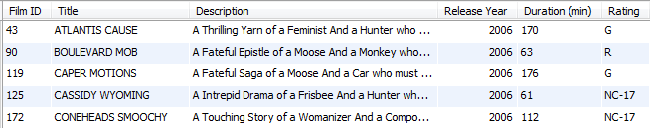

Using Stored Procedures
Procedures with IN variables: Just call procedure to get results.
call sakila.getMovies(34);
Procedures with IN and OUT variables: Need SELECT statement to get results
call sakila.getActorName(34, @fname, @lname);
select @fname, @lname;

Slide 5
Stored Procedures (1)
create procedure getActorName (IN id smallint, OUT fname varchar(45), OUT lname varchar(45))
BEGIN
SELECT first_name, last_name
INTO fName, lName
FROM actor
WHERE actor_id = id;
END
From MySQL
call getActorName(4, @fname, @lname);
select @fname, @lname;
JENNIFER DAVIS
create procedure getActorID (IN fname varchar(45), IN lname varchar(45), OUT id smallint )
BEGIN
SELECT actor_id
INTO id
FROM actor
WHERE first_name = fname AND last_name = lname;
END
From MySQL
call getActorID ('JENNIFER','DAVIS', @id);
select @id;
4
Note use of INTO clause

Slide 6
Stored Procedures (2)
create procedure getMovieTitle (IN id smallint, OUT movieTitle varchar(255))
BEGIN
SELECT title
INTO movieTitle
FROM film
WHERE film_id = id;
END
From MySQL
call getMovieTitle(252, @title);
select @title;
DREAM PICKUP
create procedure getMovieID (IN movieTitle varchar(255), OUT id smallint)
BEGIN
SELECT film_id
INTO id
FROM film
WHERE title = movieTitle;
END
From MySQL
call getMovieID('DREAM PICKUP', @id); select @id;
252

Slide 7
Stored Procedures (3)
create procedure getMovies (IN id smallint)
BEGIN
SELECT film_id as 'Film ID',
title as Title, description as Description, release_year as 'Release Year', length as 'Duration (min)',
rating as Rating, name as Genre
FROM film_actor
JOIN film using (film_id)
JOIN film_category using (film_id)
JOIN category using (category_id)
WHERE actor_id = id;
END

Slide 8
Stored Procedures (4)
create procedure isFamilyFriendly (IN id smallint, OUT familyFriendly bool)
BEGIN
SELECT case
when rating in ('PG', 'G') then true
else false
end
INTO familyFriendly
FROM film
WHERE film_id = id;
END
From MySQL
Call isFamilyFriendly(40, @familyFriendly);
select @familyFriendly;
0

Slide 9
Stored Procedures (5)
create procedure getActors (IN id smallint)
BEGIN
SELECT actor_id as 'Actor ID', first_name as 'First Name', last_name as 'Last Name'
FROM film
JOIN film_actor using (film_id)
JOIN actor using (actor_id)
JOIN film_category using (film_id)
JOIN category using (category_id)
WHERE film.film_id = id;
END

Slide 10
Triggers
DROP TRIGGER IF EXISTS set_proposal_number //
CREATE TRIGGER set_proposal_number BEFORE INSERT ON curriculum_proposals
FOR EACH ROW BEGIN
-- proposal_numbers should start with the current
-- year, followed by a dash, followed by the -- sequence in that year e.g., 2016-1, 2016-2, etc.
SELECT ifnull(max(right(proposal_number, length(proposal_number) - instr(proposal_number, '-'))), 0) + 1
INTO @nextPnumForYear
FROM curriculum_proposals
WHERE left(proposal_number, 4) = year(now());
SET NEW.proposal_number = concat(year(now()), '-', @nextPnumForYear);
END; //
Trigger: a named database object, associated with a table, that activates when a particular event occurs for the table.
Some uses for triggers are to perform checks of values to be inserted into a table or to perform calculations on values involved in an update.
before or after
Insert, delete or update
Run BEFORE triggers
Evaluate constraints, enforce NOT NULL, apply DEFAULT values
Write the row to the database
Update indexes
Run AFTER triggers
SEQUENCE OF EVENTS

Slide 11
More on Triggers
DROP TRIGGER IF EXISTS curriculum_proposal_audit_trail //
CREATE TRIGGER curriculum_proposal_audit_trail AFTER UPDATE ON curriculum_proposals
FOR EACH ROW BEGIN
-- Create an audit trail record for all of the old values in curriculum_proposals
INSERT INTO curriculum_proposals_audit_trail
(proposalID, proposal_number, title, course_name, proposal_type,
date_submitted, date_approved_college, date_approved_provost, date_record_state)
VALUES
(OLD.proposalID, OLD.proposal_number, OLD.title, OLD.course_name, OLD.proposal_type,
OLD.date_submitted, OLD.date_approved_college, OLD.date_approved_provost, now());
END; //
Event | Values Available
INSERT |  | NEW
UPDATE | OLD | NEW
DELETE | OLD
Run BEFORE triggers
Evaluate constraints, enforce NOT NULL, apply DEFAULT values
Write the row to the database
Update indexes
Run AFTER triggers

Slide 12
Programming at Web Server Level

Slide 13

Disclaimer
The following techniques describe only the most rudimentary PHP / HTML and therefore are meant only to get a quick web database application up and running.
What, no AJAX ??

Slide 14
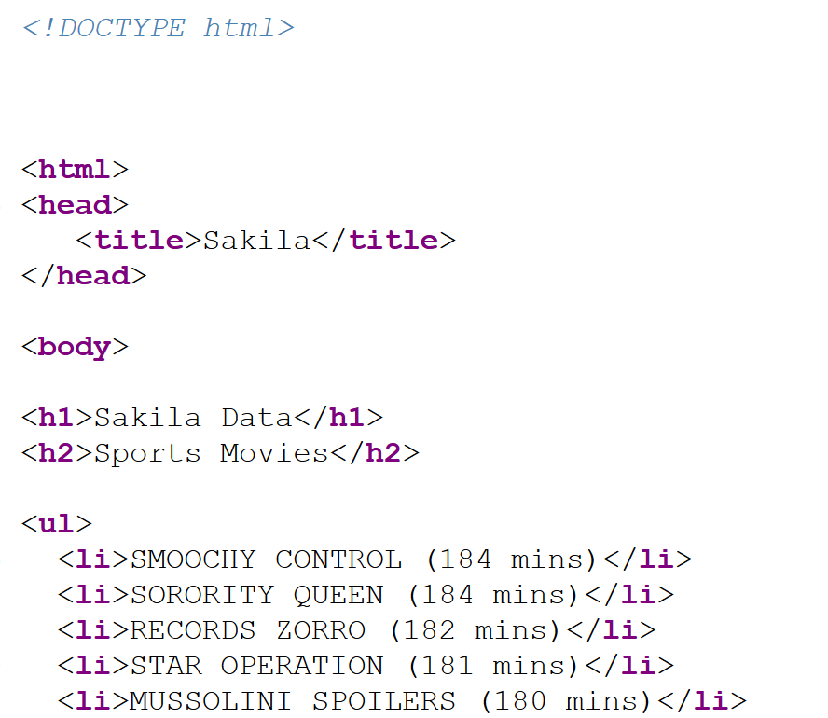
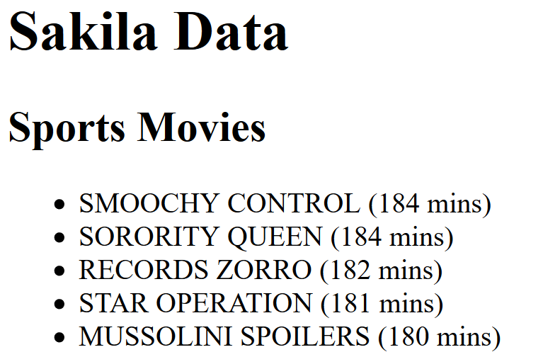
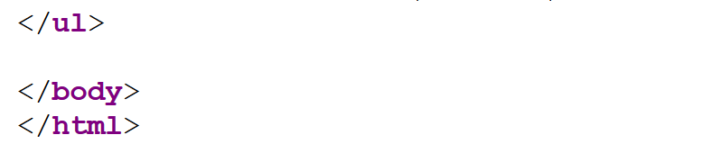
Sakila HTML PHP and Text File at http://elvis.rowan.edu/~myersjac/sakila/
<!DOCTYPE html> defines document type
<html> </html> contains HTML content
<head> </head> HTML header used for title and links to CSS stylesheets
<title> </title> Title in browser window
<body> </body> Viewable on webpage
<h1> </h1> 1st level heading
<ul> </ul> Unordered list
<li> </li> Listiitem
sakila.html
…

Slide 15
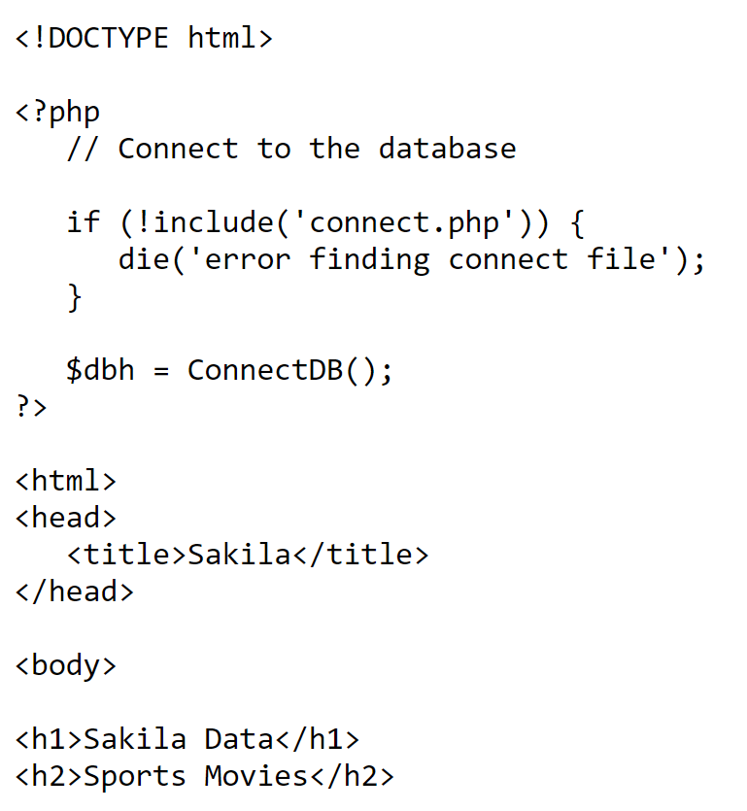
PHP code
HTML enhanced with PHP should be stored in a .php file
PHP code is embedded in between <?php ?> tag
PHP syntax
Variables, e.g., $dbh, must start with $
Java-like syntax; statements end with ;
PHP functions
include: (or require) brings in another PHP script
die: prints a message and ends the script
PHP code processed on server, thus only echoed output is rendered in the browser.
sakila.php

Slide 16
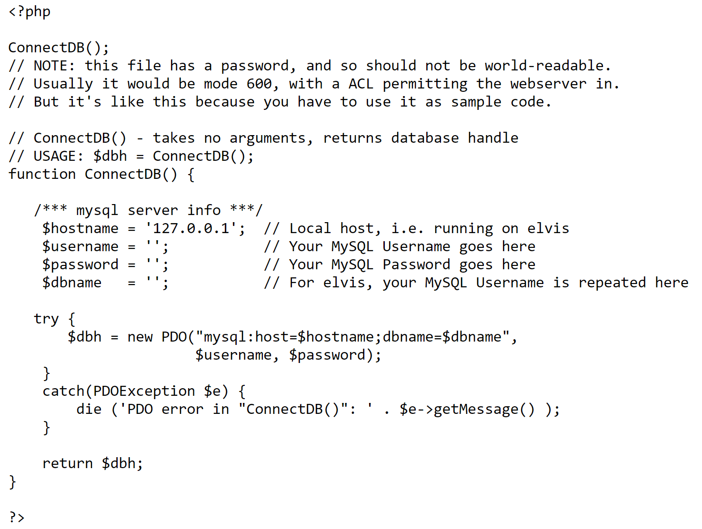
connect.php Using PHP Data Objects (PHP PDO)
PHP function which returns a database handle

Slide 17
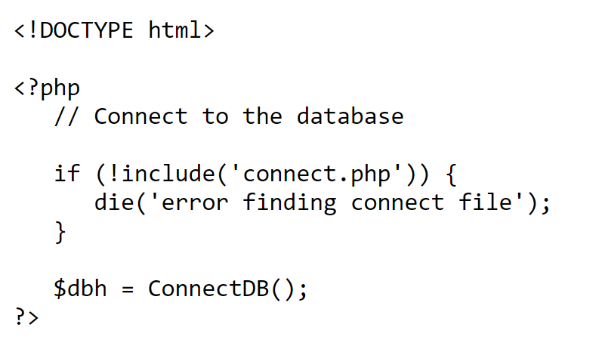
sakila.php Using PHP Data Objects (PHP PDO)
Embedded PHP at the beginning of the document to make connection to database and store the database handle in variable $dbh

Slide 18
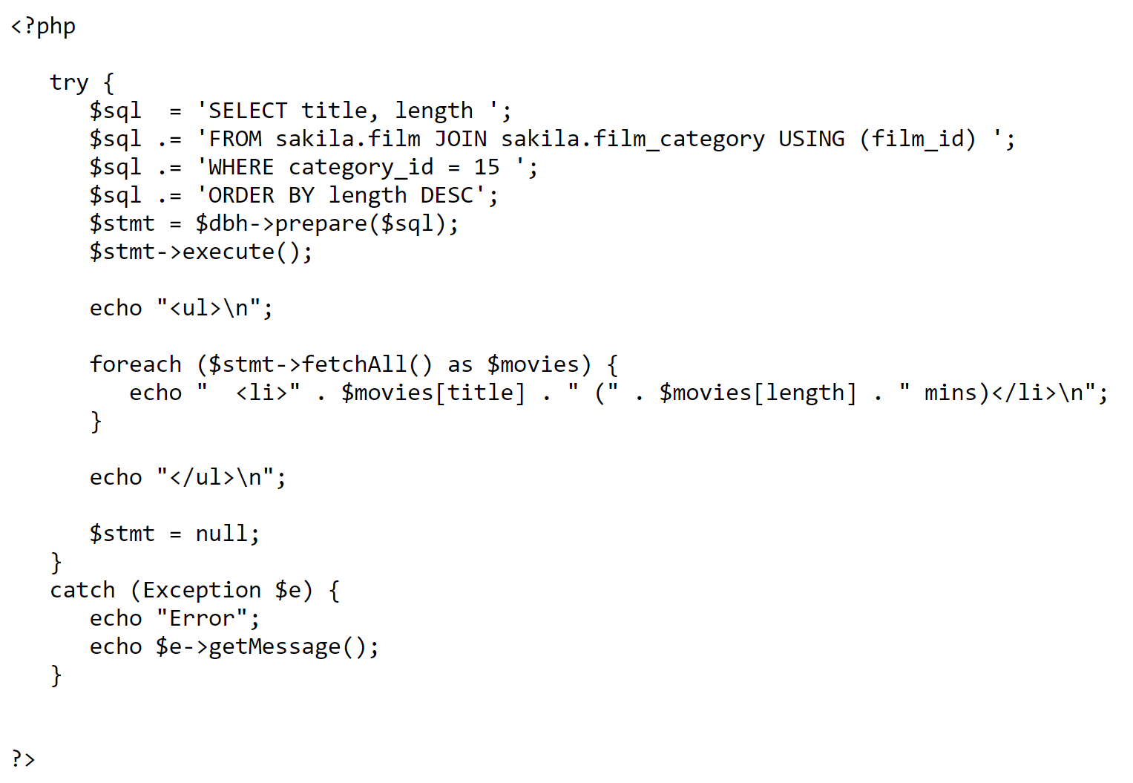
sakila.php Using PHP Data Objects (PHP PDO)
Create SQL statement and store it in variable $sql
. is the concatenation operator. Concatenation used to make SQL statements easily readable in PHP file
Use the database handle to prepare the SQL, which returns a PDO statement. Execute the statement.
fetchAll() returns an array containing all of the result set rows, The array can be looped thru; columns are the elements of each row.
Echoing the line break character has no effect on the HTML page (<br /> is used for that.) But it makes the HTML code easier to read upon view source

Slide 19
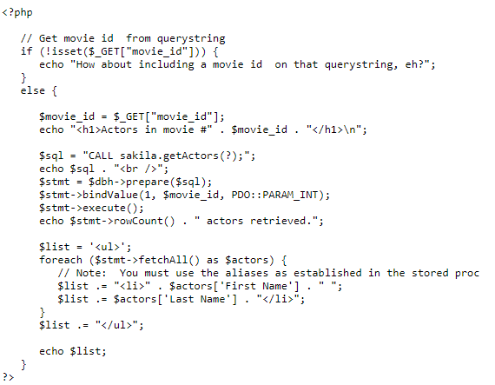
Running a stored IN procedure
Use the database handle to prepare the SQL, which returns a PDO statement. Execute the statement.
? is an alternate way to find
This proc is an IN proc, not an IN/OUT proc. Thus no second SQL statement is needed to retrieve the OUT parameters.
fetchAll() returns an array containing all of the result set rows, The array can be looped thru; columns are the elements of each row.

Slide 20
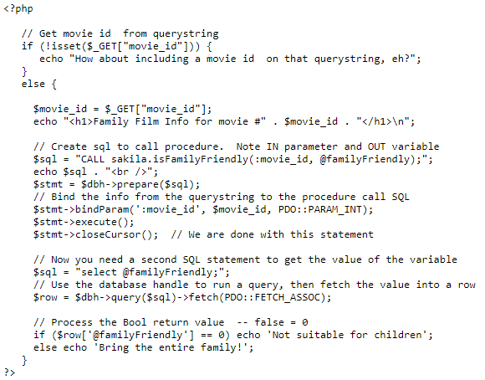
Running a stored IN/OUT procedure

Slide 21
Using GET

Slide 22
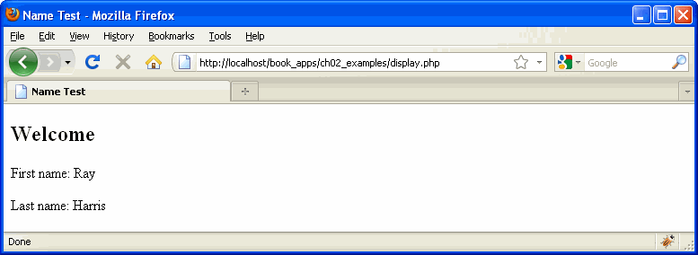
Using POST

Slide 23
Using Strings

Slide 24
Echo
Embedded variables
<?php $color = "red"; echo "Roses are $color"; echo "<br>"; echo 'Roses are $color'; ?>
Single quotes will print the variable name, not the value
Roses are red Roses are $color

Slide 25
More Advanced Work
See http://elvis.rowan.edu/~myersjac/sakila/tablesAndViews.txt
See http://elvis.rowan.edu/~myersjac/sakila/listTable.txt

Slide 26
MySQL vs. Oracle

Slide 27
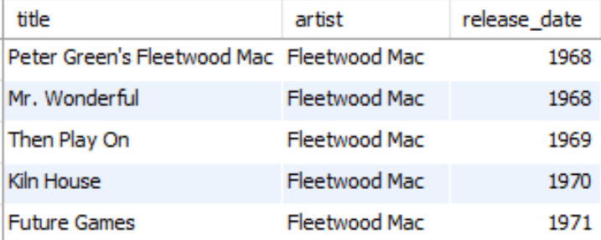
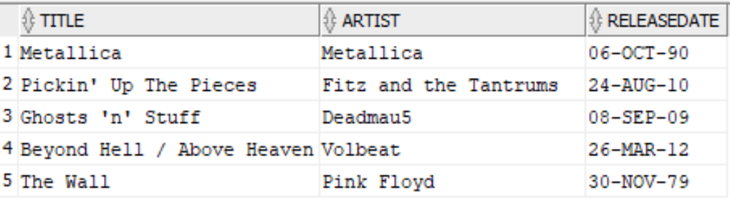
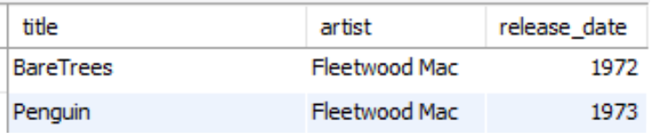
Limiting rows
MySQL Oracle
LIMIT
select artist, title, release_date from my_cds limit 5; select artist, title, release_date from my_cds limit 5, 2;
Use of ROWNUMs
select title, artist, releasedate
from cd
where rownum < 6;
In Oracle 11, specifying the range is not possible.
However, in Oracle 12, there is a new OFFSET operator.

Slide 28
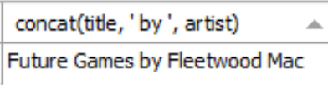

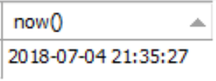


Other functions
MySQL Oracle
Concatenation
select concat(title, ' by ', artist) from my_cds;
SELECT with no FROM
select now();
Concatenation
select title || ' by ' || author
from book;
Use of table dual.
select systimestamp from dual;
to_char
select to_char(systimestamp, 'DD-MON-YYYY HH24:MI:SS') from dual;
Oracle also has a to_date function for converting strings to dates.

Slide 29
Procedures
MySQL Oracle
Concatenation
select concat(title, ' by ', artist) from my_cds;
SELECT with no FROM
select now();
Concatenation
select title || ' by ' || author
from book;
Use of table dual.
select systimestamp from dual;
to_char
select to_char(systimestamp, 'DD-MON-YYYY HH24:MI:SS') from dual;
Oracle also has a to_date function for converting strings to dates.

Slide 30
SQL*Plus tips: Listing tables

Slide 31
SQL*Plus tips: Setting the page size

Slide 32
SQL*Plus tips: Setting the column sizes (1)

Slide 33
SQL*Plus tips: Setting the column sizes (2)
You have a default 80 character linesize
But you can set linesize 132 or any other value

Slide 34
Oracle Procedures (see website for conversion reference)

Slide 35
Procedures and Functions
Oracle subprograms – includes both procedures and functions.
Both procedures and functions:
Can be programmed to perform a data processing task.
Are named PL/SQL blocks, and both can be coded to take parameters to generalize the code.
Can be written with declarative, executable, and exception sections.
Functions are typically coded to perform some type of calculation.
Primary difference – procedures are called with PL/SQL statements while functions are called as part of an expression.

Slide 36
Procedures and Functions
Procedures and functions:
Normally stored in the database within package specifications – a package is a sort of wrapper for a group of named blocks.
Can be stored as individual database objects.
Are parsed and compiled at the time they are stored.
Compiled objects execute faster than nonprocedural SQL scripts because nonprocedural scripts require extra time for compilation.
Can be invoked from most Oracle tools like SQL*Plus, and from other programming languages like C++ and JAVA.

Slide 37
CREATE PROCEDURE Syntax
CREATE [OR REPLACE] PROCEDURE <procedure_name> ( <parameter1_name> <mode> <data type>, <parameter2_name> <mode> <data type>, ...) {AS|IS}
<Variable declarations>
BEGIN
Executable statements
[EXCEPTION
Exception handlers]
END <optional procedure name>;
Unique procedure name is required.
OR REPLACE clause facilitates testing.
Parameters are optional – enclosed in parentheses when used.
AS or IS keyword is used – both work identically.
Procedure variables are declared prior to the BEGIN keyword.
DECLARE keyword is NOT used in named procedure.

Slide 38
A Procedure with an Error
You cannot just SELECT, you must SELECT INTO

Slide 39
The Procedure Fixed

Slide 40
Passing IN and OUT Parameters
CREATE OR REPLACE PROCEDURE DisplaySalary2( p_EmployeeID IN CHAR, p_Salary OUT NUMBER) IS
v_Salary NUMBER(10,2);
BEGIN
SELECT Salary INTO v_Salary FROM Employee
WHERE EmployeeID = p_EmployeeID;
IF v_Salary > 15000 THEN
DBMS_OUTPUT.PUT_LINE ('Salary > 15,000.');
ELSE
DBMS_OUTPUT.PUT_LINE ('Salary <= 15,000.');
END IF;
p_Salary := v_Salary;
EXCEPTION
WHEN NO_DATA_FOUND THEN
DBMS_OUTPUT.PUT_LINE ('Employee not found.');
END DisplaySalary2;
Assignment operator in PL/SQL is :=

Slide 41
Calling a procedure in a SQL script
/* */
DECLARE
v_SalaryOutput NUMBER := 0;
BEGIN
-- call the procedure
DisplaySalary2('01885', v_SalaryOutput);
-- display value of salary after the call
DBMS_OUTPUT.PUT_LINE ('Actual salary: '
||TO_CHAR(v_SalaryOutput));
END;
/
Output:
Salary > 15,000.
Actual salary: 16250
PL/SQL procedure successfully completed.

Slide 42
Oracle Functions (see website for conversion reference)

Slide 43
Create Function Syntax
Like a procedure, a function can accept multiple parameters, and the data type of the return value must be declared in the header of the function.
CREATE [OR REPLACE] FUNCTION <function_name> (<parameter1_name> <mode> <data type>,
<parameter2_name> <mode> <data type>, ...)
RETURN <function return value data type> {AS|IS}
<Variable declarations>
BEGIN
Executable Commands
RETURN (return_value);
. . .
[EXCEPTION
Exception handlers]
END;

Slide 44
Printing
Set serveroutput on
If then else
Loops
:= for assignment

Slide 45
Sample Function

Slide 46
PL/SQL syntax

Slide 47
PL/SQL: Conditionals
DECLARE
a number(3) := 100;
BEGIN
IF ( a = 10 ) THEN
dbms_output.put_line('Value of a is 10' );
ELSIF ( a = 20 ) THEN
dbms_output.put_line('Value of a is 20' );
ELSIF ( a = 30 ) THEN
dbms_output.put_line('Value of a is 30' );
ELSE
dbms_output.put_line('None of the values is matching');
END IF;
dbms_output.put_line('Exact value of a is: '|| a );
END;
/

Slide 48
PL/SQL Loops: Basic Loop
DECLARE
x number := 10;
BEGIN
LOOP
dbms_output.put_line(x);
x := x + 10;
IF x > 50 THEN
exit;
END IF;
END LOOP;
-- after exit, control resumes here
dbms_output.put_line( 'After Exit x is: ' || x);
END;
/
DECLARE
x number := 10;
BEGIN
LOOP
dbms_output.put_line(x);
x := x + 10;
exit WHEN x > 50;
END LOOP;
-- after exit, control resumes here
dbms_output.put_line( 'After Exit x is: ' || x);
END;
/

Slide 49
PL/SQL Loops: While and For Loops
DECLARE
a number(2) := 10;
BEGIN
WHILE a < 20 LOOP
dbms_output.put_line( 'value of a: ' || a);
a := a + 1;
END LOOP;
END;
/
DECLARE
a number(2);
BEGIN
FOR a in 10 .. 20 LOOP
dbms_output.put_line( 'value of a: ' || a);
END LOOP;
END;
/

